Slide 1


PANIMALAR ENGINEERING COLLEGE
Department of Computer Science and Engineering
CS8811 PROJECT WORK
COAL MINE SYSTEM FOR SAFETY ALERTING
AND MONITORING
Project Guide: MR.M.MAHENDRAN
Team Members:
Praveen Kumar.p
Sharath Kumar.m
Siddhaarth.s
Batch Number:C17

Slide 2
Presentation Outline
Introduction
Motivation
Literature survey
Inferences from Literature Survey
Objectives
System Architecture
Description of Software for Implementation
Project Management Plan
References
Q&A

Slide 3
Introduction
Mines are the world’s most dangerous place to work because in the mines, explosion often happens and thousand people are dying.
And a recent report states that in such mine accidents an average of around 12,000 people have died.
Coal is a nonsustainable origin that cannot be widely replaced by humans, there are several mishaps of coalmines occurring in the mines.
The diggers are putting their lives at risk, by working in the coal mines, even once in a while they end up losing their lives in the coal mines that are an unfortunate part.
Mainly such mishaps happen as a direct result of the old equipment and wired devices, resulting in the end, mishandling, spillage of the noxious gases in the coal mines.

Slide 4
Introduction
So we’ve designed the coalmine protection system to stay away from this problem.
We tackled the issues in our research by testing each of the information collected by the sensors, we use and finishing the analysis using the Thinger system.
It possess self-organized capability by wireless communication.
There must be no interruptions to the communication network at any time or under any circumstance.
In this project, a low-cost, early-warning intelligence-based wireless mine supervision system is proposed. IoT allows for monitoring of worker status.
Every two minutes, all sensor data is sent to a remote IOT server. A buzzer alert is also included in the circuit.

Slide 5
Motivation
The motivation for the mentioned project is from a Tamil movie named “O2” ,which I watched recently.
Trapped in a lanslide,the passenger of the bus gets struck,as the time passes lack of oxygen happens ,the location of the bus couldn’t be identified.This is the plot of the movie.
To reduce the risk of causing death under low supply of oxygen and other calamities in Coal Mine.
“An Approach for Understanding and Promoting Coal Mine Safety by Exploring Coal Mine Risk Network”- Coal mining refers to one of the most hazardous industries worldwide.

Slide 6
Literature Review
S. No | Title | Author | Content | Pros | Cons
1. | IOT based Coal Mine Safety Monitoring And Alerting System | Manohara K M, Nayan Chandan D C, Pooja S V, Sonika P, Ravikumar K I | Every parameter, such as methane gas, high temperature, fire incidents, etc., should be regularly checked in the underground mining business. Due to the complexity of the mining environment and the variety of activities performed in coal mines, it is important to monitor the working environment. To address this issue, there is a system that monitors basic safety measures and regulates many restrictions on coal mines, such as gas leaks, temperature and humidity conditions, and fire sensor. All the sensors are assembled into a single unit and then placed in a coal mine. | For the purpose of implementing security and detecting dangers within a coal mine, the IOT-based coal mine safety monitoring and alerting system project is proposed. Temperature, smoke, and methane sensors have been installed in the transmitter module. An LCD and an RF transmitter are also housed in the transmitter module. | This involves identifying and analysing all technical and non-technical issues facing an enterprise then defining mitigation measures to bring the risks to an acceptable level. Each management decision can then be based on this risk analysis process as well as best practices and corporate governance standards.

Slide 7
Literature Review
S. No | Title | Author | Content | Pros | Cons
2. | Coal Mine Safety Monitoring and Alerting System with Smart Helmet | Mangesh Rudrawar, Shivam Sharma, Madhuri Thakur, Vivek Kadam | Traditional monitoring systems in coal mines are difficult to install, hazardous, and difficult to power. Because of the complexity of the mining environment and the wide range of operations performed in coal mines, it is vital to monitor and maintain the parameters in the background t increase the efficiency and safety of mineworkers. As a result, traditional monitoring methods cannot be relied on to ensure coal workers’ safety. This research represents a ZigBee-based wireless monitoring system using a smart helmet. | A clever mining helmet has been developed that is capable of detecting the following three kinds of potentially hazardous situations:levels of toxic gas, removal of the mining helmet, collision, and impact.A miner removing their mining helmet from their head was deemed dangerous.When miners are struck by an object that is against their will and has a force greater than 1000 on the HIC (Head Injury Criteria), this is another dangerous situation. | Since the technology used in Zigbee is of low bit rate, the transmission rate of this technology is also low.

Slide 8
Inferences from Literature Survey
From the first literature survey, they used the sensor to identify only the temperature and gas leakage.
So we like to add a sensor to find the water levels inside the coal mine to overcome the leakage of water.
From the second literature survey, the this technology used in Zigbee is of low bit rate, the transmission rate of this technology is also low.
We are going to use the same Zigbee to result with a high bit rate transmission.

Slide 9
Objectives
In this system the coal mine safety systems are fixed with gas sensors modules,temprature sensor,water level sensors and relays.
In this system we mainly have monitoring and controlling systems.
In this monitoring system we monitor all the data from different sensors.
Gas sensors detects the gas in coal environment.
These sensors values are continously uploaded to the cloud for analysis and also for further use.

Slide 10
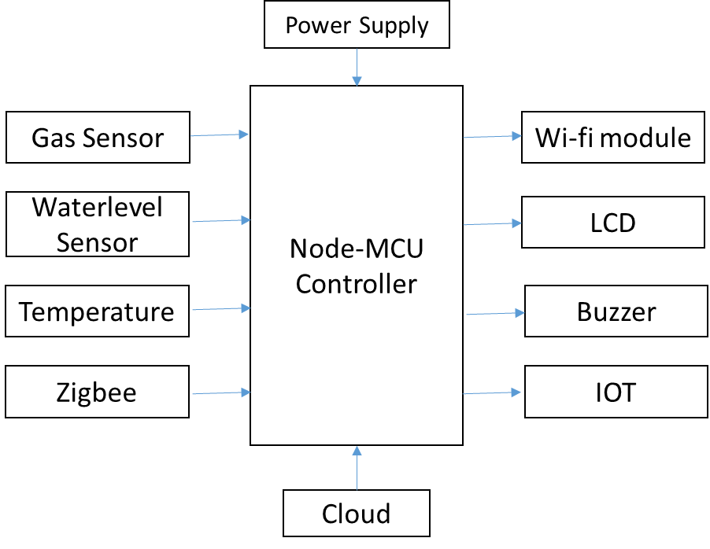
System Architecture

Slide 11
System Architecture
Hardware Used :
NodeMCU Controller
Gas sensor
Water level Sensor
Temperature Sensor
Zigbee Sensor
Wifi Module
LCD Display
Buzzer
Software Used :
Arduino IDE
Embedded C

Slide 12
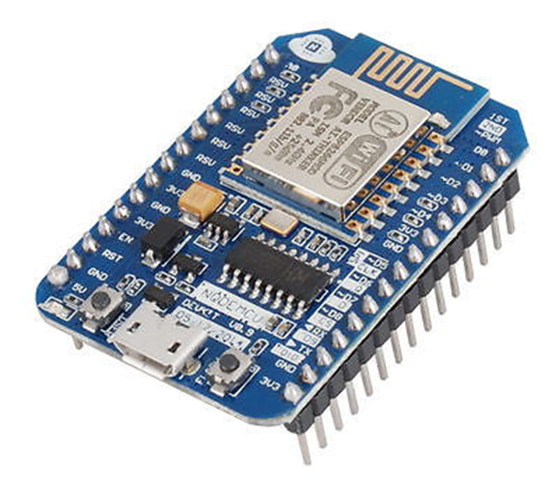
System Architecture
Node MCU :
NodeMCU is an open source IOT platform. It includes firmware which runs on the ESP8266 Wi-Fi SoC from Espressif Systems, and hardware which is based on the ESP-12 module. The term "Node MCU" by default refers to the firmware rather than the development kits. The firmware uses the Lua scripting language. It is based on the eLua project, and built on the Espressif Non-OS SDK for ESP8266. It uses many open source projects, such as lua-cjson and SPIFFS.
NodeMCU was created shortly after the ESP8266 came out. On December 30, 2013, Espressif Systems began production of the ESP8266.

Slide 13
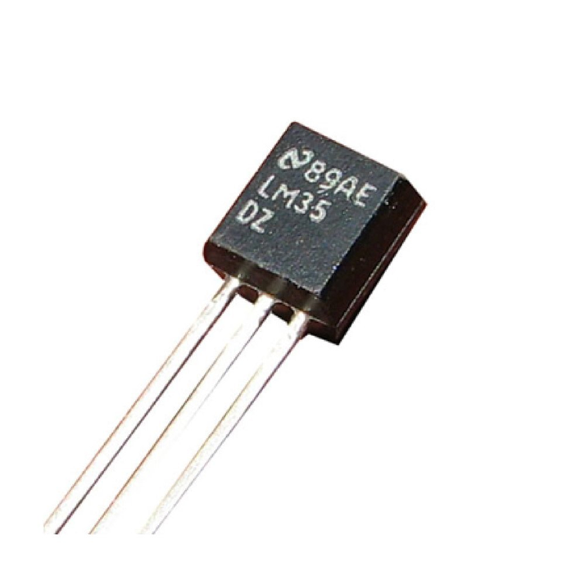
System Architecture
Another important update was made on 30 Jan 2015, when Devsaurus ported the u8glib to Node MCU project, enabling Node MCU to easily drive LCD, Screen, OLED, even VGA displays.
Temperature Sensor :
Temperature is the most often-measured environmental quantity. This might be expected since most physical, electronic, chemical, mechanical, and biological systems are affected by temperature.
Certain chemical reactions, biological processes, and even electronic circuits perform best within limited temperature ranges.

Slide 14
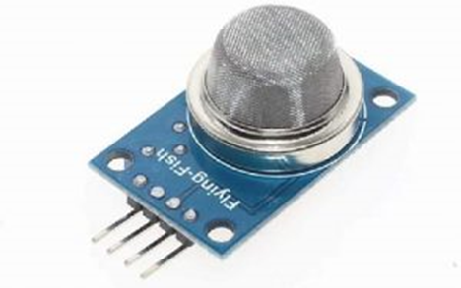
System Architecture
Temperature is one of the most commonly measured variables and it is therefore not surprising that there are many ways of sensing it.
Temperature sensing can be done either through direct contact with the heating source, or remotely, without direct contact with the source using radiated energy instead.
There are a wide variety of temperature sensors on the market today, including Thermocouples, Resistance Temperature Detectors (RTDs), Thermistors, Infrared, and Semiconductor Sensors.
Gas Sensor :
The MQ4 methane gas sensor is extremely used for detecting gas leakage at home or in industries like Methane (CH4) & CNG Gas.

Slide 15
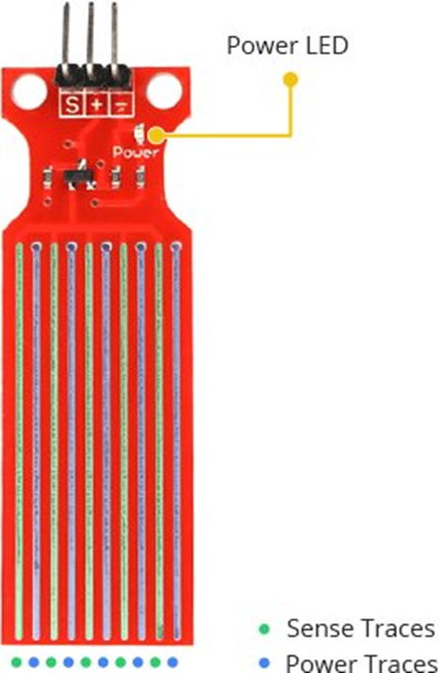
System Architecture
This gas sensor is highly responsive in very little time, so based on the sensitivity requirements; it can be adjusted through a potentiometer.
This is an analog output sensor, used like a CNG (compressed natural gas) sensor within the series of MQ sensors.
So this sensor is suitable for detecting the concentration of natural gas like methane within the air. For this sensor, if the gas concentration increases then the output voltage will be increased.
This sensor works with 5V DC and draws 750 mW around. This article discusses an overview of the MQ4 methane gas sensor and its working with applications.
Water Level Sensor :

Slide 16
System Architecture
If you have ever had a water heater explode or ever tried to make submersible electronics, then you know how important it is to detect when water is around.
With this Water Level Sensor, you can do just that!
This sensor can be used to measure the water level, monitor a sump pit, detect rainfall or detect leakage.
Hardware Overview :
The sensor has a series of ten exposed copper traces, five of which are power traces and five are sense traces.
These traces are interlaced so that there is one sense trace between every two power traces.
Usually these traces are not connected but are bridged by water when submerged.

Slide 17
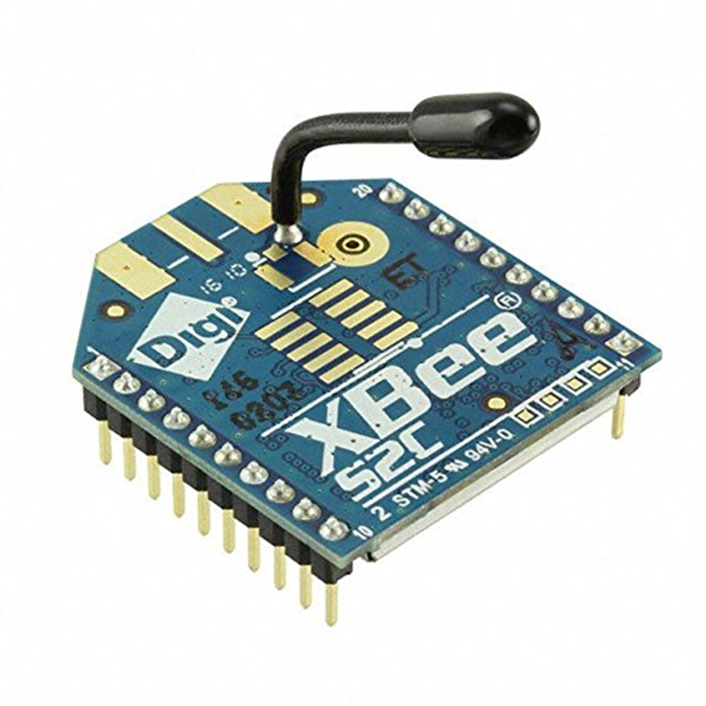
System Architecture
Zigbee :
ZigBee is a wireless technology developed as an open global standard to address the unique needs of low-cost, low-power wireless M2M networks.
TheZigBee standard operates on the IEEE 802.15.4 physical radio specification and operates in unlicensed bands including 2.4 GHz, 900 MHz and 868 MHz.
The specification is a packet-based radio protocol intended for low-cost, battery-operated devices. The protocol allows devices to communicate in a variety of network topologies and can have battery life lasting several years.

Slide 18
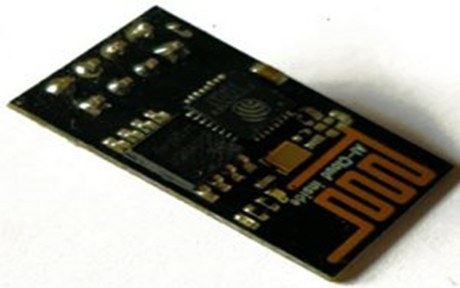
System Architecture
Wi-Fi Module :
An ESP8266 Wi-Fi module is a SOC microchip mainly used for the development of end-point IoT (Internet of things) applications. It is referred to as a standalone wireless transceiver, available at a very low price. It is used to enable the internet connection to various applications of embedded systems.
Espressif systems designed the ESP8266 Wi-Fi module to support both the TCP/IP capability and the microcontroller access to any Wi-Fi network. It provides the solutions to meet the requirements of industries of IoT such as cost, power, performance, and design.
It can work as either a slave or a standalone application. If the module is used as a standalone application, then it provides the functions of the microcontroller and Wi-Fi network.

Slide 19
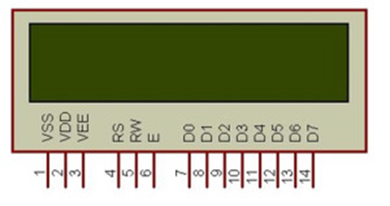
System Architecture
LCD Display :
Liquid crystal displays (LCDs) have materials which combine the properties of both liquids and crystals. Rather than having a melting point, they have a temperature range within which the molecules are almost as mobile as they would be in a liquid, but are grouped together in an ordered form similar to a crystal.
An LCD consists of two glass panels, with the liquid crystal material sand witched in between them. The inner surface of the glass plates are coated with transparent electrodes which define the character, symbols or patterns to be displayed polymeric layers are present in between the electrodes and the liquid crystal, which makes the liquid crystal molecules to maintain a defined orientation angle.

Slide 20
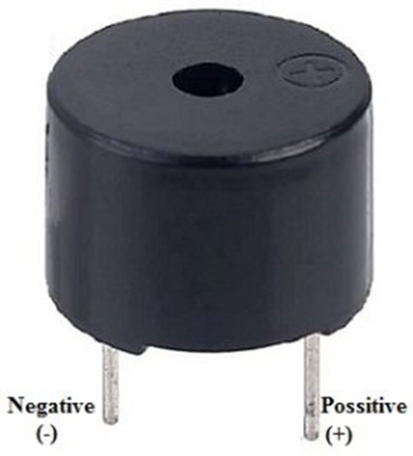
System Architecture
One each polarisers are pasted outside the two glass panels. These polarisers would rotate the light rays passing through them to a definite angle, in a particular direction.
When the LCD is in the off state, light rays are rotated by the two polarisers and the liquid crystal, such that the light rays come out of the LCD without any orientation, and hence the LCD appears transparent.
Buzzer :
An audio signaling device like a beeper or buzzer may be electromechanical or piezoelectric or mechanical type. The main function of this is to convert the signal from audio to sound. Generally, it is powered through DC voltage and used in timers, alarm devices, printers, alarms, computers, etc.

Slide 21
System Architecture
The pin configuration of the buzzer is shown below. It includes two pins namely positive and negative. The positive terminal of this is represented with the ‘+’ symbol or a longer terminal. This terminal is powered through 6Volts whereas the negative terminal is represented with the ‘-‘symbol or short terminal and it is connected to the GND terminal.

Slide 22
Description of Software for Implementation
ARDUINO IDE :
Arduino is a open source electronics platform based on easy-to-use hardware and software.
It is intended for anyone making interactive projects.
Arduino senses the environment by receiving inputs from many sensors.
It affects surroundings by controlling lights, motors, and other actuators.
EMBEDDED-C :
Embedded-C is most popular programming language in software field for developing electronic gadgets.
Embedded-C programming plays a key role in performing specific function by the processor.
We choose Embedded-C because it is easy to understand, High Reliability, Portability, Scalability.

Slide 23
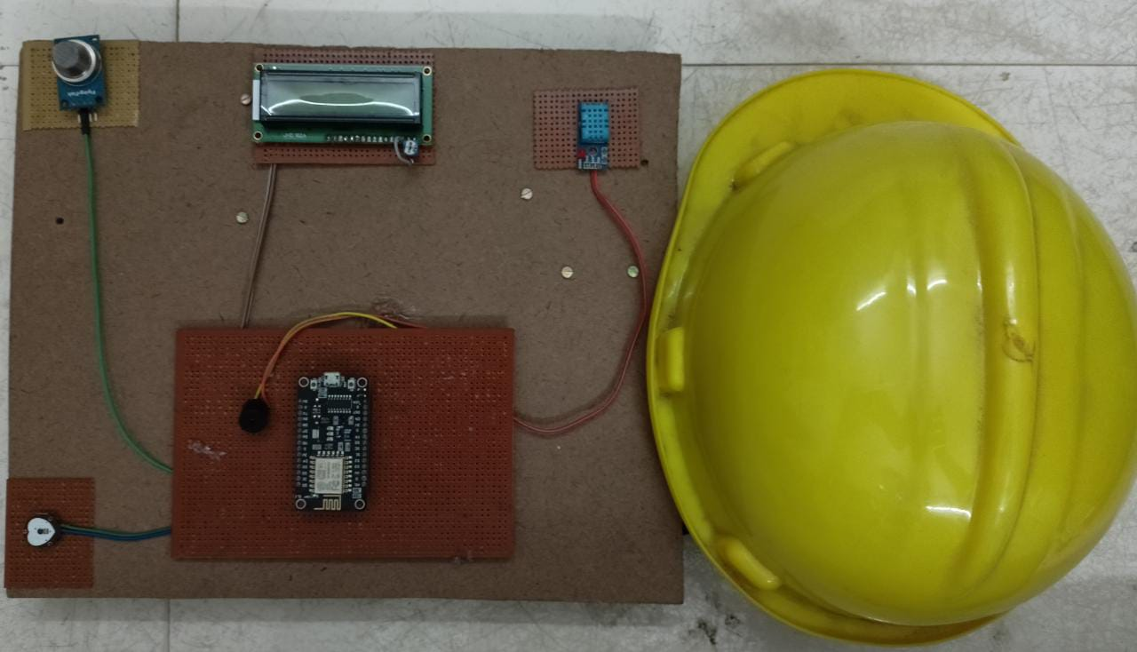
Working and Implementation

Slide 24

Source Code

Slide 25

Source Code

Slide 26

Source Code

Slide 27

Source Code

Slide 28

Source Code

Slide 29
References
Geetha, A.. (2014). Intelligent helmet for coal miners with voice over ZigBee and environmental monitoring. World Applied Sciences Journal. 20. 2328-2330. 10.5829/idosi.mejsr.2014.20.12.332.
P. Vamsikrishna, Sonti Dinesh Kumar, Shaik Riyaz Hussain and K. Rama Naidu, ”Raspberry PI controlled SMS-Update-Notification (Sun) system,” 2015 IEEE International Conference on Electrical, Computer and Communication Technologies (ICECCT), Coimbatore, India, 2015, pp. 1-4, doi: 10.1109/ICECCT.2015.7226113.
Salankar, Pranoti Anandrao and S. Suresh. “Zigbee Based Underground Mines Parameter Monitoring System for Rescue and Protection.” IOSR journal of VLSI and Signal Processing 4 (2014): 32-36.
H. Li, ”Research on safety monitoring system of workers in dangerous operation area of port,” 2017 4th International Conference on Transportation Information and Safety (ICTIS), Banff, AB, Canada, 2017, pp. 400-408, doi: 10.1109/ICTIS.2017.8047796.
A. Mishra, S. Malhotra, Ruchira, P. choudekar and H. P. Singh, ”Real Time Monitoring &amp; Analyzation Of Hazardous Parameters In Underground Coal Mines Using Intelligent Helmet System,” 2018 4th International Conference on Computational Intelligence &amp; Communication Technology (CICT), Ghaziabad, India, 2018, pp. 1-5, doi: 10.1109/CIACT.2018.8480177.

Slide 30
THANK YOU
We thank our guide and panel and all technical and non technical staff helped us in achieving this.

